Slide 1
Kernel PCA
CSCI 347
Adiesha Liyana Ralalage

Slide 2
What is kernel PCA?
Standard PCA finds the lower dimensional linear space that captures the maximum variance of the data.
However, real-world data is often nonlinear.
Kernel PCA is a technique to find non-linear relationships of data in high dimensional space.
We will go through the high-level idea of this technique without going through the exact details.

Slide 3
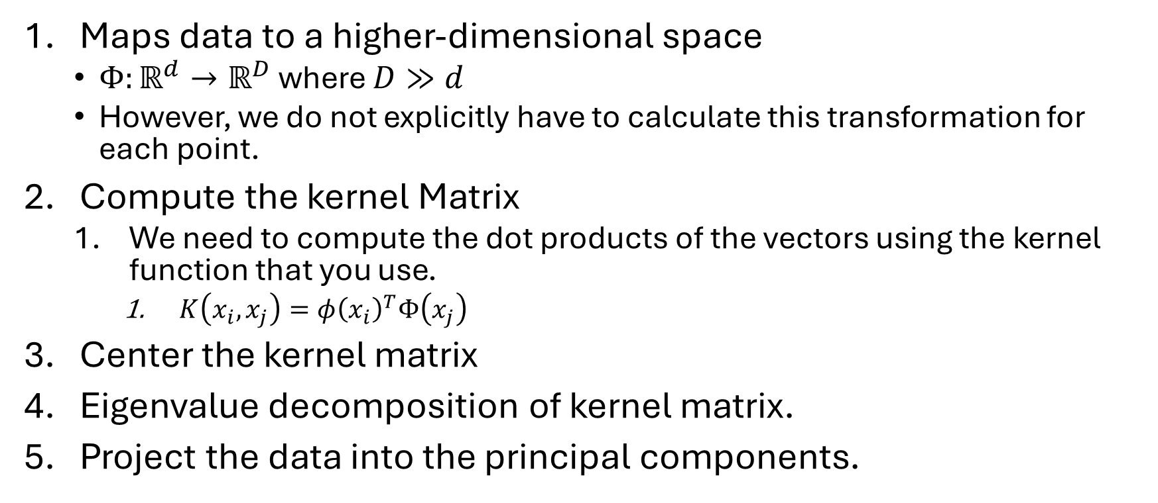
How kernel PCA works
Maps data to a higher-dimensional space
$Φ:ℝ^{d}→ℝ^{D}$ where $D≫d$
However, we do not explicitly have to calculate this transformation for each point.
Compute the kernel Matrix
We need to compute the dot products of the vectors using the kernel function that you use.
$K\left(x_{i}, x_{j}\right)=φ{\left(x_{i}\right)}^{T}Φ\left(x_{j}\right)$
Center the kernel matrix
Eigenvalue decomposition of kernel matrix.
Project the data into the principal components.

Slide 4
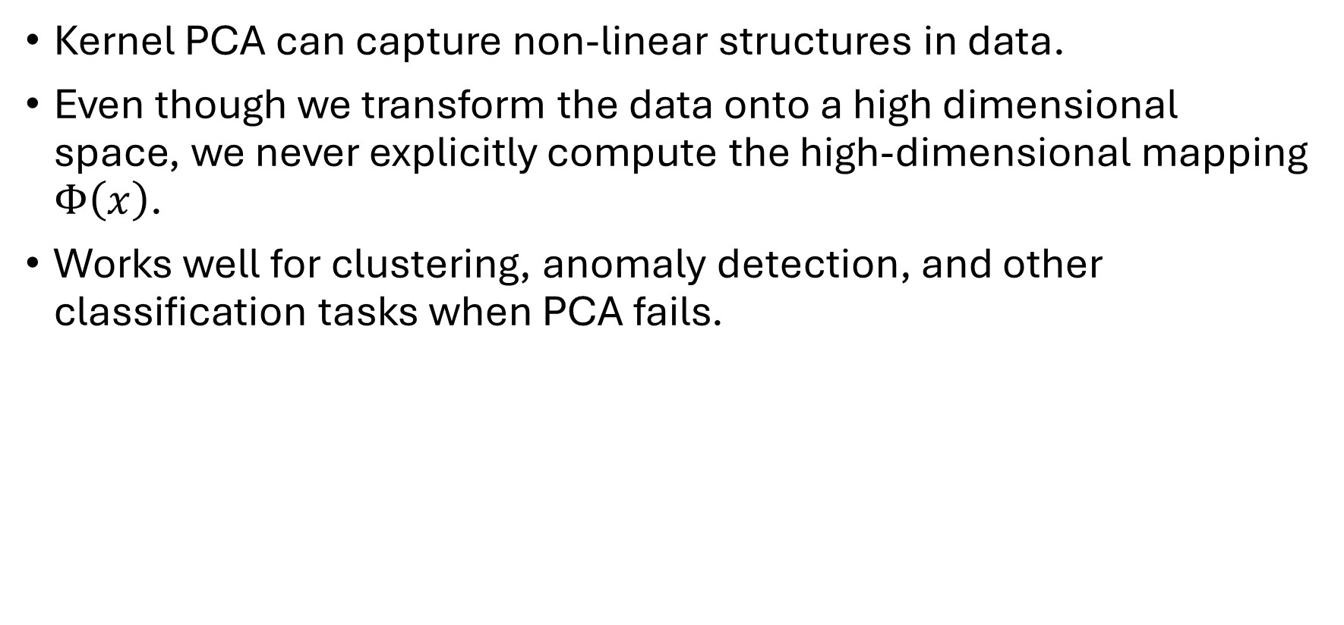
Why is this used?
Kernel PCA can capture non-linear structures in data.
Even though we transform the data onto a high dimensional space, we never explicitly compute the high-dimensional mapping $Φ\left(x\right)$.
Works well for clustering, anomaly detection, and other classification tasks when PCA fails.

Slide 5
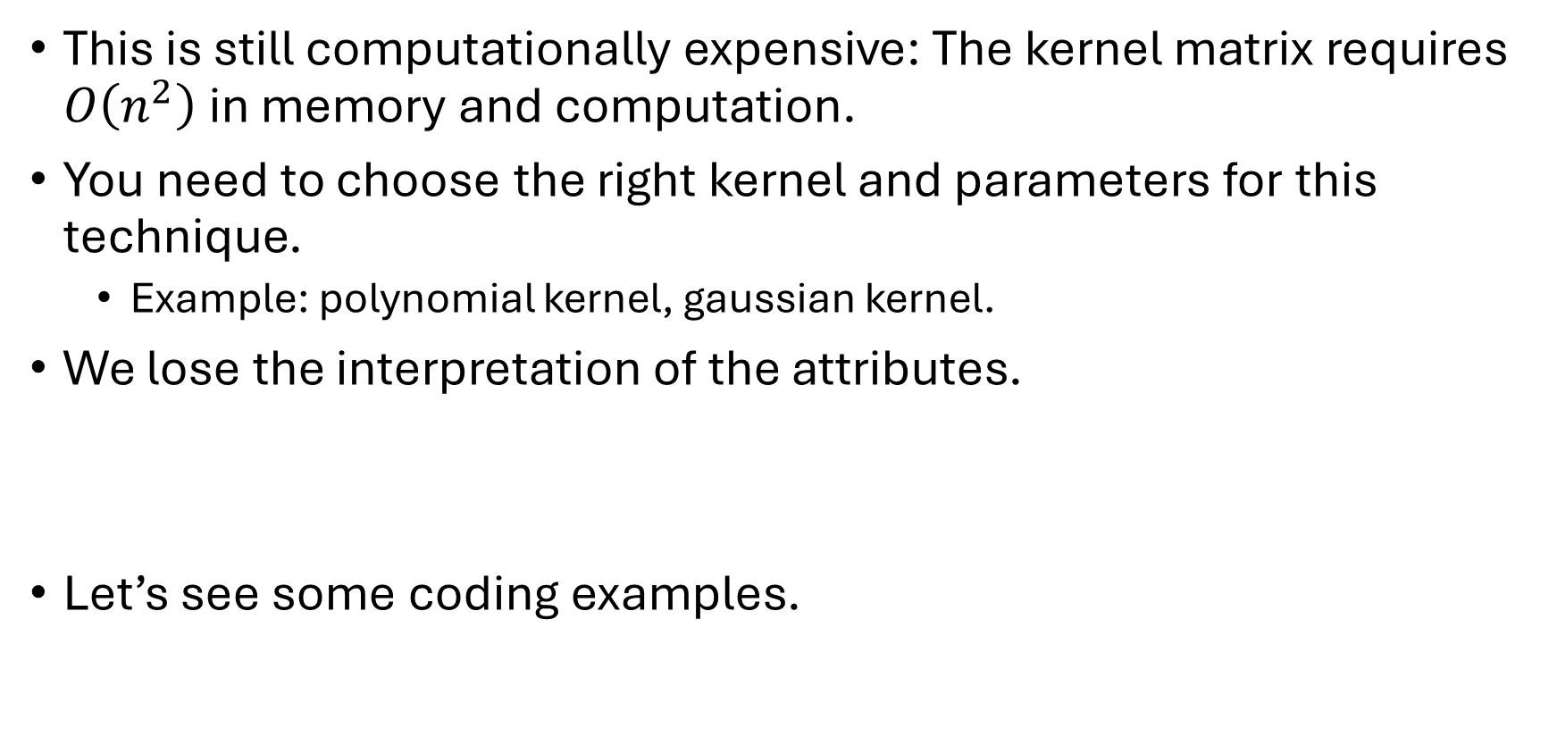
Limitations
This is still computationally expensive: The kernel matrix requires $O\left(n^{2}\right)$ in memory and computation.
You need to choose the right kernel and parameters for this technique.
Example: polynomial kernel, gaussian kernel.
We lose the interpretation of the attributes.
Let’s see some coding examples.

